Slide 1

Bangladesh Army University of Science and Technology (BAUST) Saidpur Cantonment, Nilphamari
Department of Computer Science and Engineering (CSE)
Course Code: CSE 4140
Course Title: Machine Learning Sessional
Customer Segmentation using Machine Learning
Presented By
.
Md. Robius Sany Siam
ID: 220201045
Abdul Kaum Ahmed Sumon
ID: 220201046
Presented To
.
Engr. Rohul Amin
Lecturer, CSE
Nadim Reza
Lecturer, CSE
25th November, 2025
Customer Churn Prediction using Machine Learning
01

Slide 2

Project Roadmap
01
02
Introduction & Problem Context
Research Foundation
Understanding customer segmentation challenges
Literature review and dataset exploration
03
04
Technical Implementation
Results & Insights
Methodology, models, and feature engineering
Analysis, business recommendations, and conclusions

Slide 3
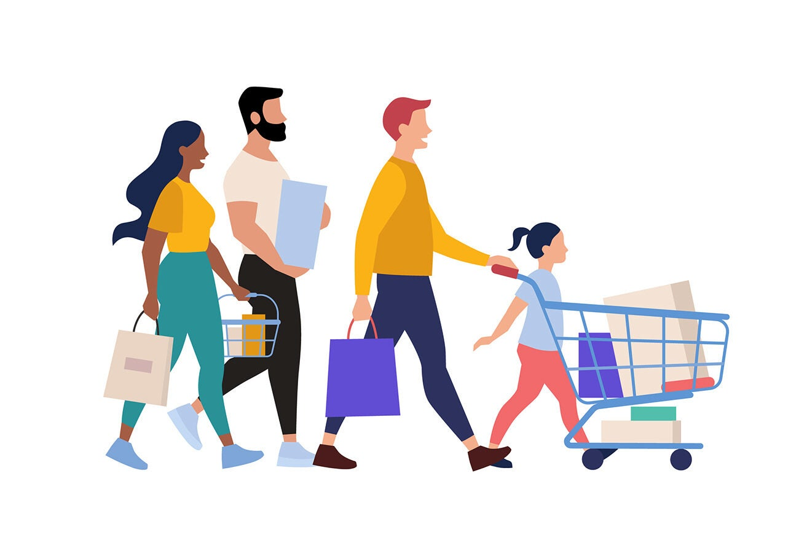
The Challenge of Modern Marketing
Problem Statement
Businesses struggle to identify their true target audiences, resulting in wasted marketing budgets on generic, one-size-fits-all campaigns that fail to resonate with diverse customer needs.
Our Solution
Data-driven customer segmentation using machine learning enables personalized marketing strategies, improves customer retention, and maximizes return on marketing investment through targeted approaches.

Slide 4
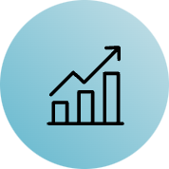







Project Objectives
Pattern Discovery
K-Means Implementation
Analyze customer data to identify distinct purchasing behaviors and demographic patterns across the customer base.
Apply K-Means clustering algorithm to segment customers into meaningful, actionable groups.
Feature Engineering
Business Recommendations
Create advanced features like Spending-to-Income Ratio to enhance cluster separation and insight quality.
Deliver actionable marketing strategies tailored to each identified customer segment.

Slide 5
Learning from Prior Research
2019: Demographic-Only Approach
1
Study: "Customer Segmentation Based on Buying Behavior"
Method: Basic K-Means using only demographic data
2
2021: Hierarchical Methods
Limitation: Ignored behavioral features like spending patterns, resulting in poor cluster separation and low silhouette scores.
Study: "Market Segmentation using Hierarchical Clustering"
Method: Agglomerative clustering on limited datasets
3
Limitation: High computational costs for large-scale data; difficult to interpret for business stakeholders.
2024: Our Integrated Approach
Innovation: Combines demographic AND behavioral data with advanced feature engineering to overcome previous limitations and deliver actionable insights.

Slide 6

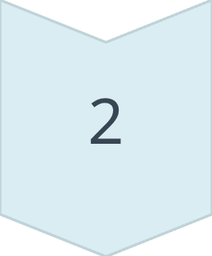
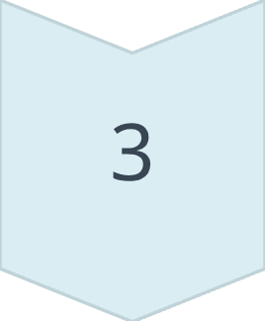
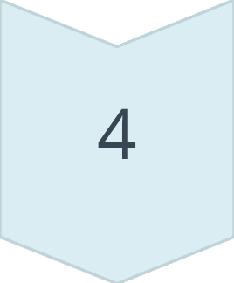
Dataset & Preprocessing Pipeline
Data Source
Preprocessing Steps
Source: Kaggle Mall Customers Dataset
Data Cleaning
Size: 200 samples with 5 features
Removed CustomerID (non-predictive)
Core Features
Age (demographic)
Encoding
Annual Income (k$)
Gender: Male=0, Female=1
Spending Score (1-100 scale)
Gender (categorical)
Feature Engineering
Created Spending_to_Income_Ratio
Standardization
Applied StandardScaler for normalization

Slide 7
Our Methodology
1
Data Loading
Import and initial exploration
2
Preprocessing
Cleaning and encoding
3
Feature Engineering
Create derived features
4
Scaling
StandardScaler normalization
5
Optimal K
Elbow Method (K=4)
6
Training
K-Means clustering
7
Visualization
Interpret and analyze results

Slide 8

Model Comparison & Selection
Model
Interpretability
Training Speed
Best Use Case
K-Means
High
Fast
Distinct, well-separated clusters
GMM
Medium
Moderate
Overlapping data with soft assignments
DBSCAN
Low
Fast
Outlier detection in density-based patterns
Final Selection: K-Means clustering provided the most distinct, interpretable, and actionable business insights for our customer segmentation task, achieving high silhouette scores indicating excellent cluster separation.

Slide 9

Customer Segments & Strategic Insights
1
2
Budget Customers
General Customers
Profile: Low Income, Low Spending
Profile: Average Income, Average Spending
Strategy: Offer promotional discounts, budget-friendly product lines, and value bundles to attract price-sensitive shoppers.
Strategy: Implement standard promotions, loyalty reward programs, and seasonal campaigns to maintain engagement.
3
4
Premium Customers
Cautious Savers
Profile: High Income, High Spending
Profile: High Income, Low Spending
Strategy: Deploy exclusive VIP services, luxury product offerings, personalized experiences, and premium membership programs.
Strategy: Focus marketing on quality, durability, and long-term value propositions to convert high-earners into active spenders.

Slide 10
Conclusions & Future Directions
Key Achievements
Successfully segmented customers into 4 distinct, actionable groups using K-Means clustering. The Premium Customer segment represents the highest revenue potential and should be prioritized for targeted marketing campaigns.
Future Research Scope
Integrate real-time purchasing data streams for dynamic segmentation
Implement Deep Learning autoencoders for complex feature extraction
Deploy interactive web application (Streamlit) for marketing team accessibility
Expand to multi-channel customer behavior analysis

Slide 11
References
[1] A. K. Jain, "Data clustering: 50 years beyond K-means," Pattern Recognition Letters, 2010.
[2] Kaggle Dataset: Mall Customer Segmentation Data
[3] Scikit-learn Documentation: Clustering Algorithms

Slide 12
Thank You
Questions & Discussion

